Slide 1
Digital Footprints

Slide 2
Digital foot prints
Digital footprint is the data trail left by your interactions in the digital world. It’s a public record of
1, what you said
2,what was said about you
3,what you liked,
4,retweeted or shared
5,where you are, or have been Although it’s less public, there’s also a record of what you’ve clicked on what you’ve searched for, your IP address

Slide 3
Digital footprints
Websites you visit place cookies on your computer to allow advertisers to target you with products based on your browsing history. And it’s surprisingly easy to publish information about you online. Even if you aren’t in the public eye, at some point someone might want to gather information about you with the intention of discrediting you.
A "passive digital footprint" is a data trail you unintentionally leave online. For example, when you visit a website, the web server may log your IP address which identifies your Internet service provider and your approximate location.

Slide 4
An "active digital footprint" includes data that you intentionally submit online. Sending an email contributes to your active digital footprint, since you expect the data be seen and/or saved by another person.
Publishing a blog and posting on social media updates are another popular ways to expand your digital footprint. Every tweet you post on Twitter, every status update you publish on Facebook and every photo you share on Instagram contributes to your digital footprint. The more you spend time on social networking websites, the larger your digital footprint will be. Even "liking" a page or a Facebook post adds to your digital footprint, since the data is saved on Facebook's servers

Slide 5
Taking control of your digital footprints
Why is it important to be in control of your digital footprint? Employers can, and do, Google people who apply for jobs with them. They could check social media sites that appear in the search to see whether you’re the kind of person they want working for them. Criminals gather information about you to fraudulently impersonate you – things like applying for credit cards or gaining access to sites or systems in your name.

Slide 6
Tidy up after yourself! – Always take time to google yourself find out what
Don’t rely on privacy settings.
First of all, understand that using privacy settings doesn’t protect you. Friends, acquaintances or others who have permission to see your pages can still download your pictures and repost them elsewhere, and comments can be retweeted or shared without your permission – either in fun, in error, or maliciously. So, if there’s something you don’t want to lose control of, don’t put it in the public domain – even privately. Secondly, privacy settings change regularly. Check them often. Finally, don’t include any private information – like your phone number or address – on your profile. Even information like your birthdate, place of work or pet names can be used against you for social engineering

Slide 7
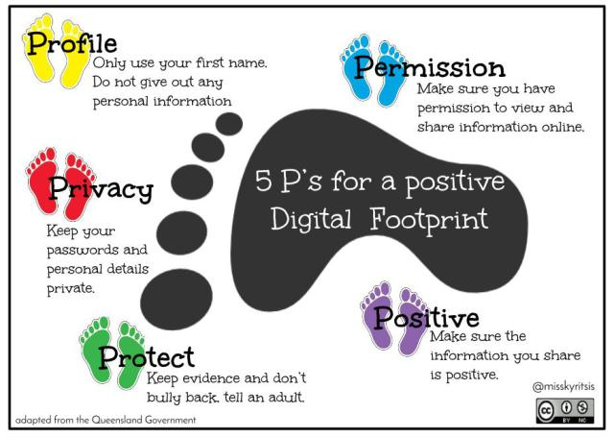

Slide 8
1.Create a strong password 2.Have different passwords for different accounts 3.Download apps from authentication platforms and use two-factor authentication 4.Log out of your accounts 5.Don’t use public WIFI for sharing sensitive information, like online bank details 6. Use antivirus software and, if possible, use a virtual private network

