Slide 1
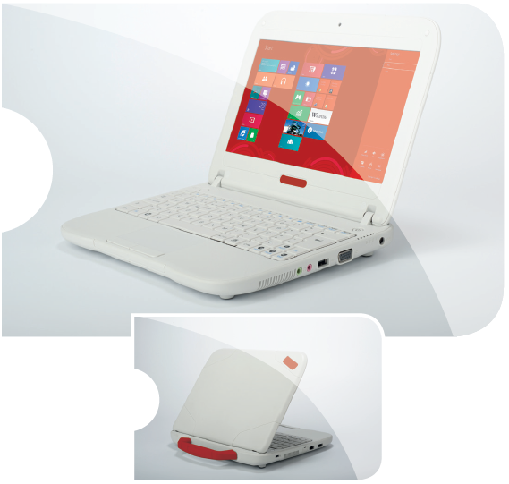
Millennium@EDU Solution Pack By JP-IK
Individual Units (IU)
Student Netbook (MG101A6)
Windows 8 ready, in compliance with ILS®
CPU: Frequency >1.0GHz Number of Cores 2
Memory: 2GB Type DDR3
LCD: Size 10.1” Resolution 1366x768 (HD) Anti-Glare
Wi-Fi: Standard 802.11 B/G/N Frequency 2.4GHz
Storage: Type SSD Capacity 32GB
Webcam: Resolution 1.0M
Security: TPM Chip - Theft Deterrent compliant
Card Reader: Type 2 in1 Format Support SDHC / MMC
I/O: USB Ports 2 2x Jacks for Microphone/Headphone
Battery: 3 cells
Software: Includes ILS® Software Stack
O.S.: Windows 8⁽¹⁾ or Linux Millennium 1.0⁽²⁾
(1)Millennium@EDU initiatives will benefit from special conditions for licensing Windows 8, Windows 8 Pro, Microsoft Office and Office 365, including value added funds, under the terms and conditions of Microsoft's "Shape the Future" program, aimed at helping governments invest in education technology to create jobs, drive economic growth and increase competitiveness. For more information, see http://facebook.com/shapethefutureproject
(2) Millennium@EDU Linux is based in Debian Wheezy merged with contributions and enhancements of the member organizations of OpenMillennium Initative. This version has been totally supported and certified for Millennium@Edu computers, giving a guarantee of total hardware support and performance optimization. It can be used and transformed by local and regional groups or companies, adapting it to the needs of each region. For more information, see http://www.openmillennium.org/
(1)(2) Requires negotiation with the software developer.
The presented images are merely illustrative.
For more information please click here
7 | Millennium@EDU Solution Pack Guidance by JP-IK | nov 2012

